Slide 1
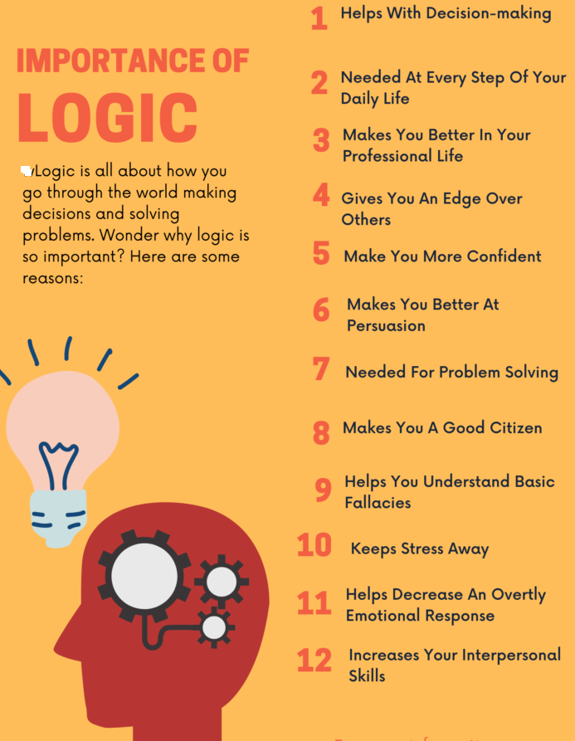

Slide 2

Resolution Proof Method
IN PROPOSITIONAL LOGIC

Slide 3
Resolution Proof Method
It was proposed by J.A. Robinson in 1965 as a proof method for classical logics
Dedicated theorem provers based on resolution:
OTTER, PCPROOVE, AMPHION, Jape
It was easily adapted to nonstandard logics (modal, temporal, many-valued, non-monotonic).
Its basic aim is to check the consistency/inconsistency of a set of clauses.
It is based on syntactic considerations => syntactic method
The validity of a formula is proved by contradiction=>
=> refutation method

Slide 4
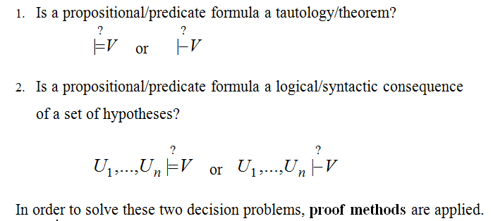
DECISION PROBLEMS IN PROPOSITIONAL/PREDICATE LOGIC

Slide 5
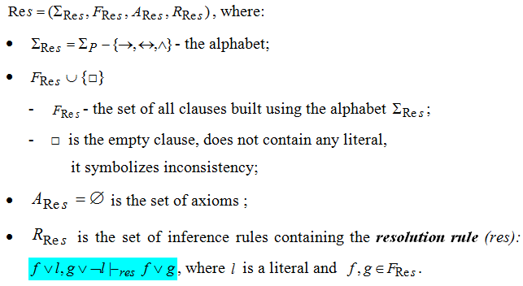
Resolution method - formal system for propositional logic -

Slide 6
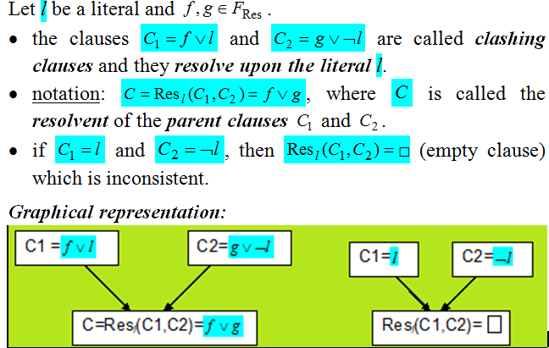
Definitions

Slide 7
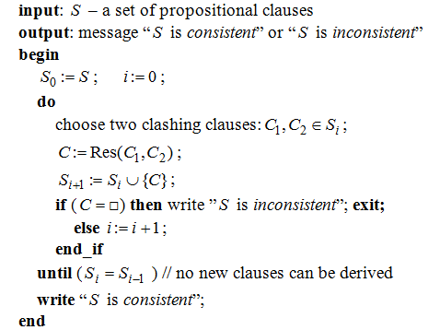
Algorithm: General_propositional_resolution

Slide 8
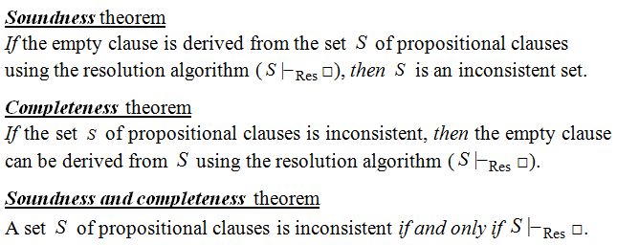
Theoretical Results

Slide 9
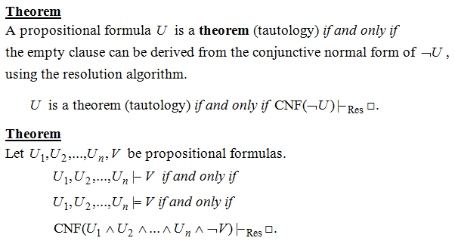
Resolution - a refutation Proof method

Slide 10
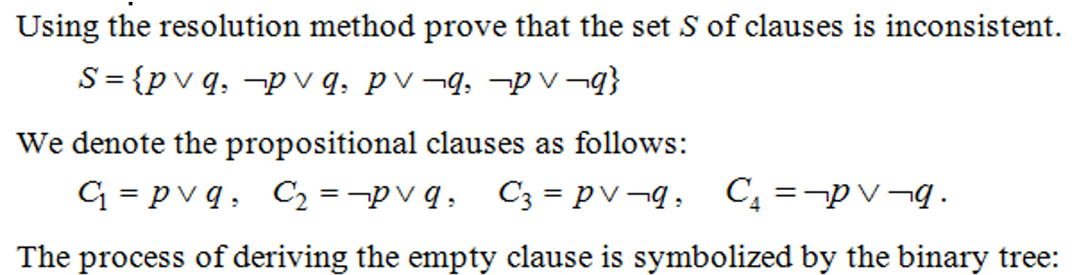
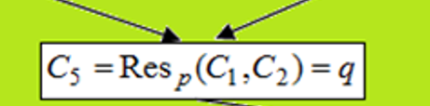
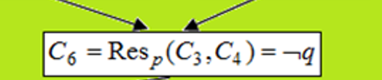

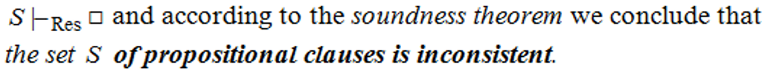
Example 1

Slide 11
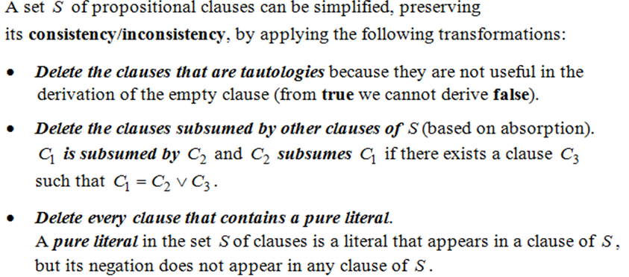
Theorem (based on Davis-Putman procedure)

Slide 12
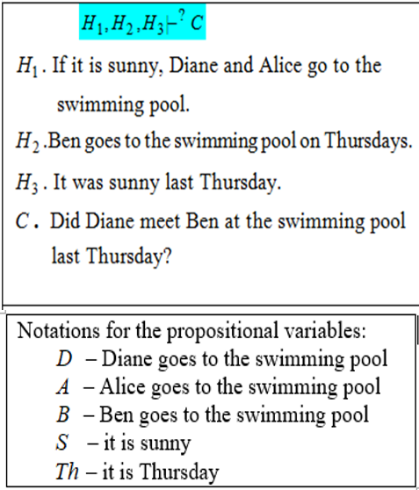
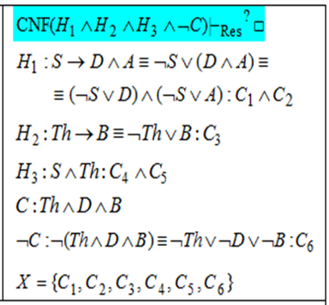
Example 2. Modeling reasoning

Slide 13
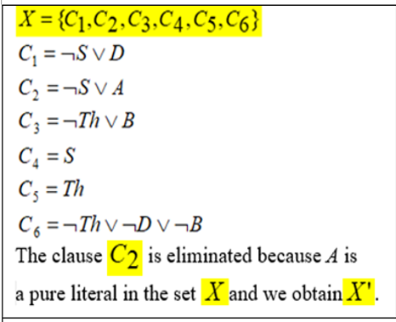
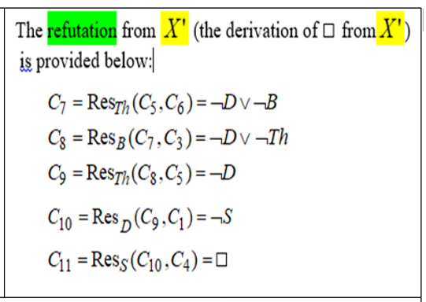
Example 2 – general Resolution(contd.)

Slide 14
Strategies and Refinements of Resolution
Strategies:
assure that all the possible clauses to be derived are generated
try to avoid the derivation of redundant and irrelevant clauses in order to obtain the empty clause.
level-saturation strategy, deletion strategy,
set-of-support strategy
Refinements
make the resolution process more efficient by imposing restrictions on the clashing clauses
lock resolution, linear resolution,
semantic resolution

Slide 15
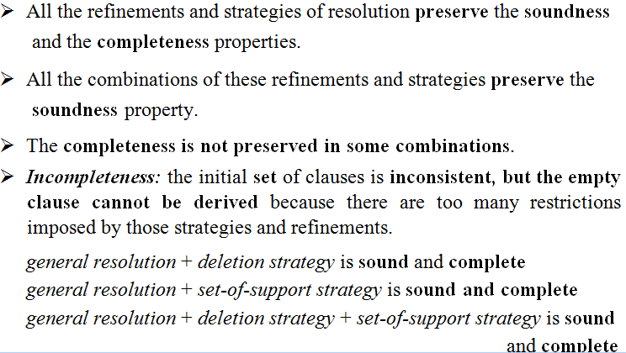
Remarks

Slide 16
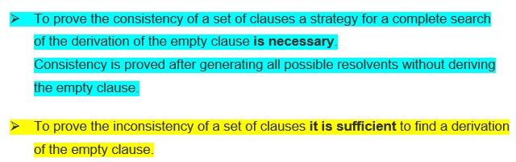
IMPORTANT!

Slide 17
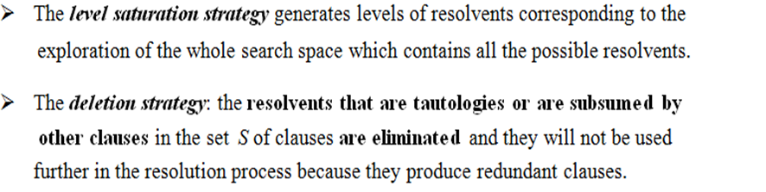
Strategies of Resolution

Slide 18
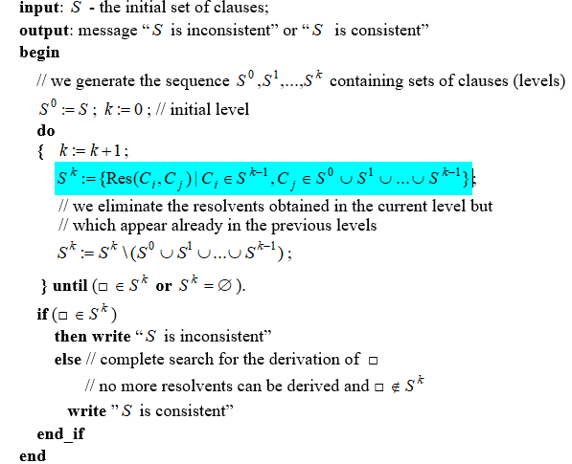
Algorithm: level-saturation-strategy

Slide 19
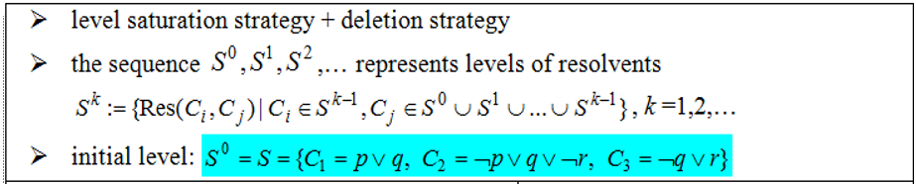
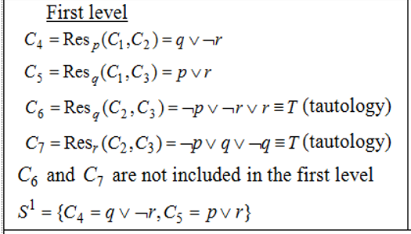
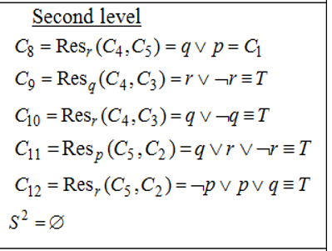

Example 3

Slide 20
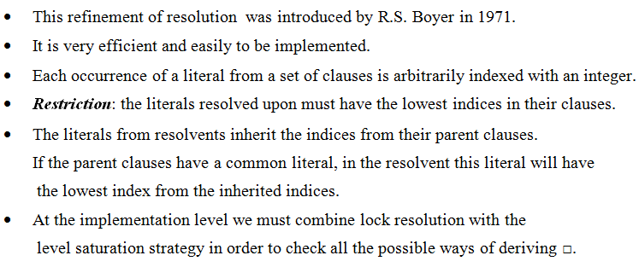
Lock Resolution

Slide 21
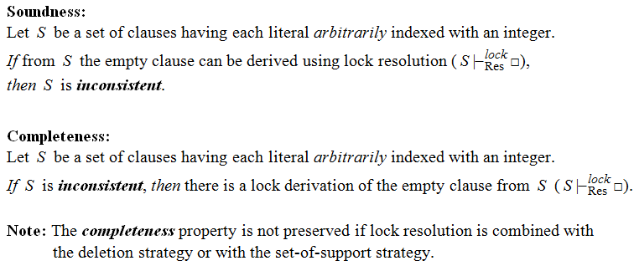
Theorems – Lock resolution

Slide 22
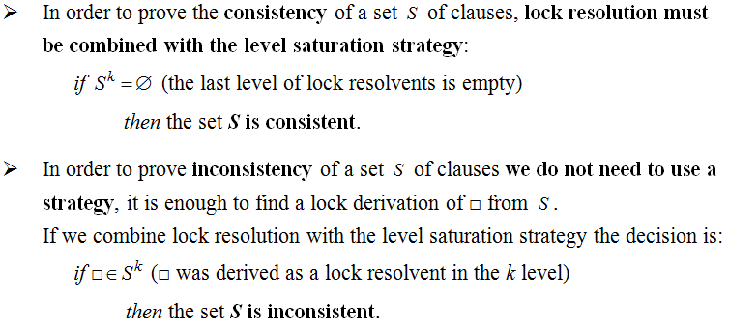
Remarks

Slide 23
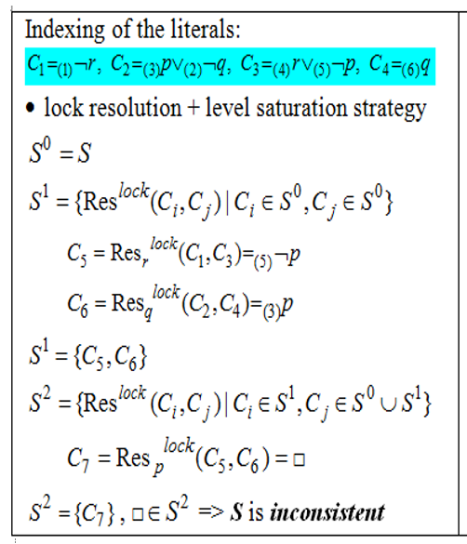
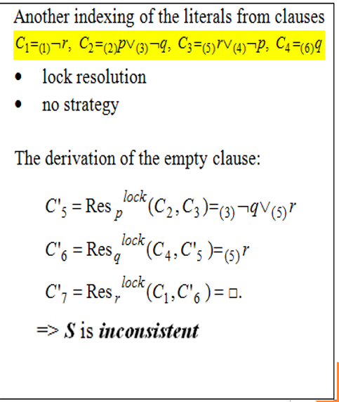
Example 4

Slide 24
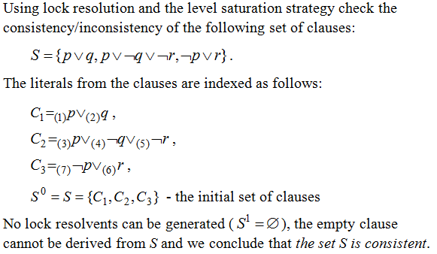
Example 5

Slide 25

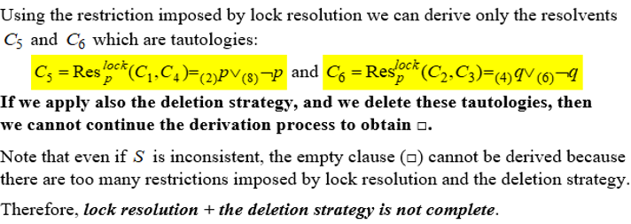
Example 6

Slide 26
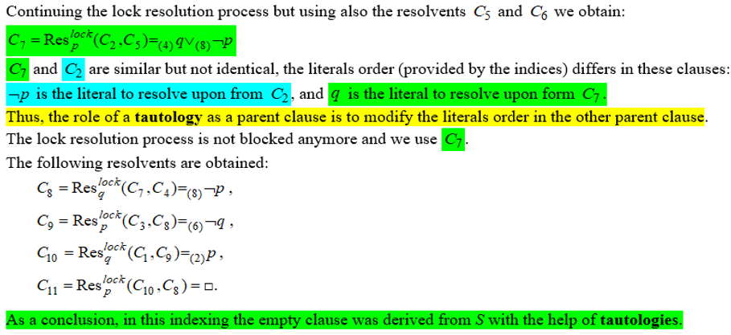
Example 6 (contd.)

Slide 27
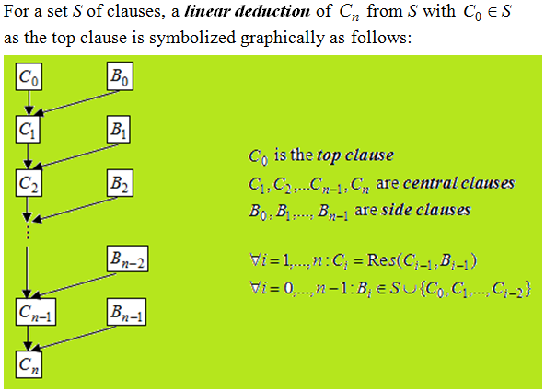
Linear Resolution (Loveland 1971)

Slide 28
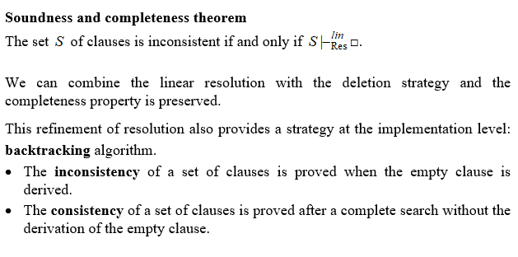
Theoretical results

Slide 29
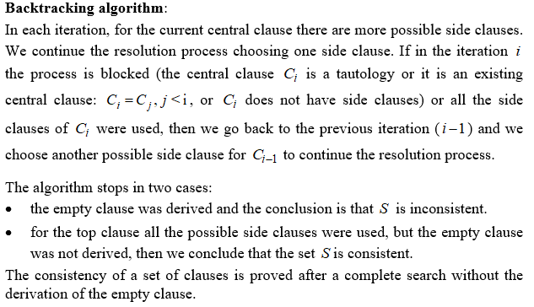

Slide 30
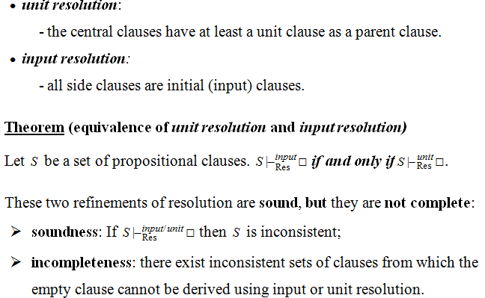
Special cases of linear resolution

Slide 31
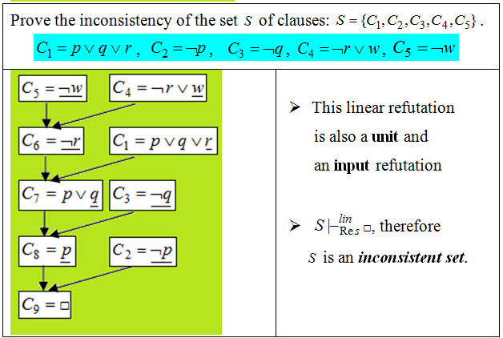
Example 8

Slide 32
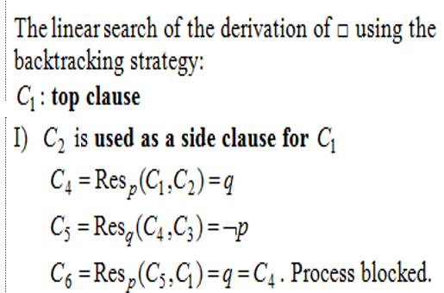
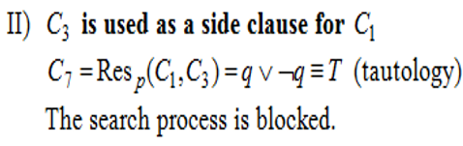
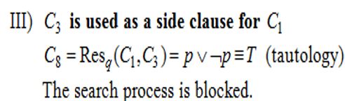
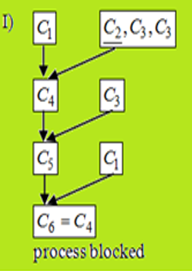
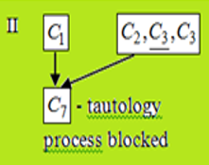
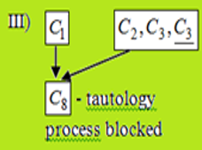

Slide 33
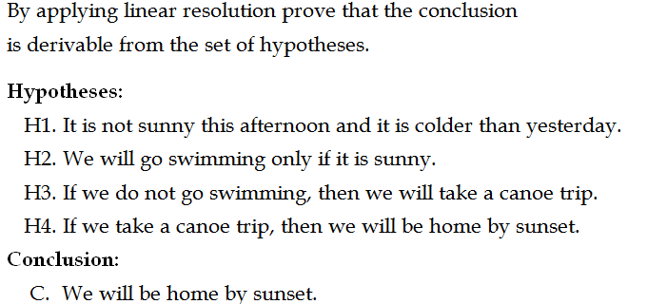
Example 9. Modeling reasoning

